Slide 1
UNIT-1.2
Database system concept and architecture, data model schema and instances, data independence

Slide 2
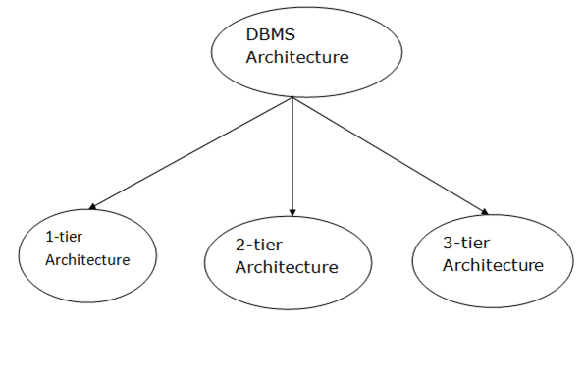
DBMS Architecture
The DBMS design depends upon its architecture. The basic client/server architecture is used to deal with a large number of PCs, web servers, database servers and other components that are connected with networks.
The client/server architecture consists of many PCs and a workstation which are connected via the network.
DBMS architecture depends upon how users are connected to the database to get their request done.
Types of DBMS Architecture

Slide 3
Database architecture can be seen as a single tier or multi-tier. But logically, database architecture is of two types like:
2-tier architecture and 3-tier architecture.
1-Tier Architecture
In this architecture, the database is directly available to the user. It means the user can directly sit on the DBMS and uses it.
Any changes done here will directly be done on the database itself. It doesn't provide a handy tool for end users.
The 1-Tier architecture is used for development of the local application, where programmers can directly communicate with the database for the quick response.

Slide 4
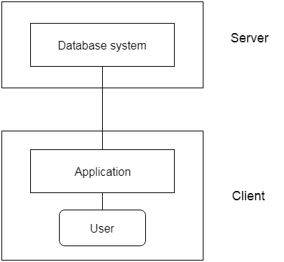
2-Tier Architecture
The 2-Tier architecture is same as basic client-server. In the two-tier architecture, applications on the client end can directly communicate with the database at the server side. For this interaction, API's like: ODBC, JDBC are used.
The user interfaces and application programs are run on the client-side.
The server side is responsible to provide the functionalities like: query processing and transaction management.
To communicate with the DBMS, client-side application establishes a connection with the server side.

Slide 5
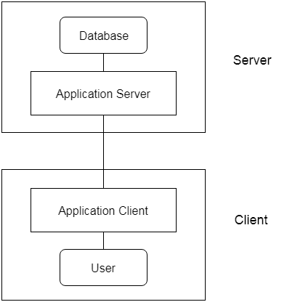
3-Tier Architecture
The 3-Tier architecture contains another layer between the client and server. In this architecture, client can't directly communicate with the server.
The application on the client-end interacts with an application server which further communicates with the database system.
End user has no idea about the existence of the database beyond the application server. The database also has no idea about any other user beyond the application.
The 3-Tier architecture is used in case of large web application.

Slide 6
Three schema Architecture
The three schema architecture is also called ANSI/SPARC architecture or three-level architecture.
This framework is used to describe the structure of a specific database system.
The three schema architecture is also used to separate the user applications and physical database.
The three schema architecture contains three-levels. It breaks the database down into three different categories.

Slide 7
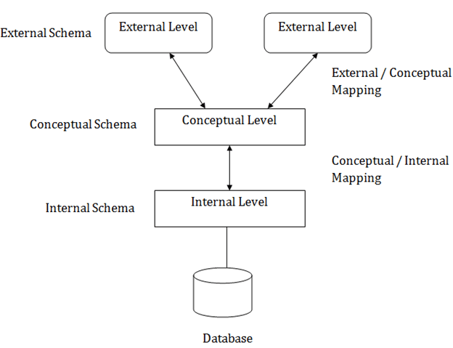
The three-schema architecture is as follows:
In the above diagram:
It shows the DBMS architecture.
Mapping is used to transform the request and response between various database levels of architecture.
Mapping is not good for small DBMS because it takes more time.
In External / Conceptual mapping, it is necessary to transform the request from external level to conceptual schema.
In Conceptual / Internal mapping, DBMS transform the request from the conceptual to internal level.

Slide 8
1. Internal Level
The internal level has an internal schema which describes the physical storage structure of the database.
The internal schema is also known as a physical schema.
It uses the physical data model. It is used to define that how the data will be stored in a block.
The physical level is used to describe complex low-level data structures in detail.
2. Conceptual Level
The conceptual schema describes the design of a database at the conceptual level. Conceptual level is also known as logical level.
The conceptual schema describes the structure of the whole database.
The conceptual level describes what data are to be stored in the database and also describes what relationship exists among those data.
In the conceptual level, internal details such as an implementation of the data structure are hidden.
Programmers and database administrators work at this level.
3. External Level
At the external level, a database contains several schemas that sometimes called as subschema. The subschema is used to describe the different view of the database.
An external schema is also known as view schema.
Each view schema describes the database part that a particular user group is interested and hides the remaining database from that user group.
The view schema describes the end user interaction with database systems.

Slide 9
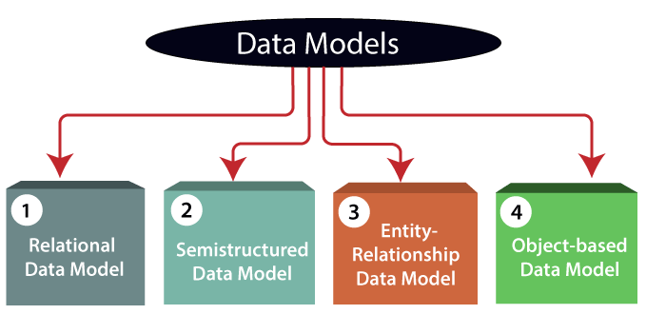
Data Models
Data Model is the modeling of the data description, data semantics, and consistency constraints of the data. It provides the conceptual tools for describing the design of a database at each level of data abstraction. Therefore, there are following four data models used for understanding the structure of the database:

Slide 10
Relational Data Model:
This type of model designs the data in the form of rows and columns within a table. Thus, a relational model uses tables for representing data and in-between relationships. Tables are also called relations. This model was initially described by Edgar F. Codd, in 1969. The relational data model is the widely used model which is primarily used by commercial data processing applications.
2) Entity-Relationship Data Model:
An ER model is the logical representation of data as objects and relationships among them. These objects are known as entities, and relationship is an association among these entities. This model was designed by Peter Chen and published in 1976 papers. It was widely used in database designing. A set of attributes describe the entities. For example, student_name, student_id describes the 'student' entity. A set of the same type of entities is known as an 'Entity set', and the set of the same type of relationships is known as 'relationship set'.

Slide 11
Data model Schema and Instance
The data which is stored in the database at a particular moment of time is called an instance of the database.
The overall design of a database is called schema.
A database schema is the skeleton structure of the database. It represents the logical view of the entire database.
A schema contains schema objects like table, foreign key, primary key, views, columns, data types, stored procedure, etc.
A database schema can be represented by using the visual diagram. That diagram shows the database objects and relationship with each other.
A database schema is designed by the database designers to help programmers whose software will interact with the database. The process of database creation is called data modeling.
A schema diagram can display only some aspects of a schema like the name of record type, data type, and constraints. Other aspects can't be specified through the schema diagram. For example, the given figure neither show the data type of each data item nor the relationship among various files.
In the database, actual data changes quite frequently. For example, in the given figure, the database changes whenever we add a new grade or add a student. The data at a particular moment of time is called the instance of the database.

Slide 12
3) Object-based Data Model:
An extension of the ER model with notions of functions, encapsulation, and object identity, as well. This model supports a rich type system that includes structured and collection types. Thus, in 1980s, various database systems following the object-oriented approach were developed. Here, the objects are nothing but the data carrying its properties
4) Semi structured Data Model:
This type of data model is different from the other three data models (explained above). The semi structured data model allows the data specifications at places where the individual data items of the same type may have different attributes sets. The Extensible Markup Language, also known as XML, is widely used for representing the semi structured data. Although XML was initially designed for including the markup information to the text document, it gains importance because of its application in the exchange of data.

Slide 13
Data model Schema and Instance
The data which is stored in the database at a particular moment of time is called an instance of the database.
The overall design of a database is called schema.
A database schema is the skeleton structure of the database. It represents the logical view of the entire database.
A schema contains schema objects like table, foreign key, primary key, views, columns, data types, stored procedure, etc.
A database schema can be represented by using the visual diagram. That diagram shows the database objects and relationship with each other.
A database schema is designed by the database designers to help programmers whose software will interact with the database. The process of database creation is called data modeling.

Slide 14
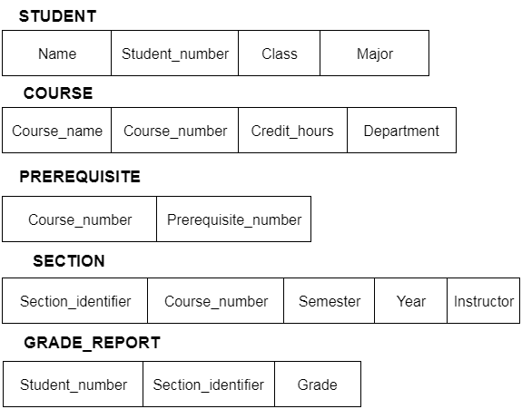
A schema diagram can display only some aspects of a schema like the name of record type, data type, and constraints. Other aspects can't be specified through the schema diagram. For example, the given figure neither show the data type of each data item nor the relationship among various files.
In the database, actual data changes quite frequently. For example, in the given figure, the database changes whenever we add a new grade or add a student. The data at a particular moment of time is called the instance of the database.

Slide 15
Data Independence
Data independence can be explained using the three-schema architecture.
Data independence refers characteristic of being able to modify the schema at one level of the database system without altering the schema at the next higher level.
There are two types of data independence:
Logical Data Independence
Logical data independence refers characteristic of being able to change the conceptual schema without having to change the external schema.
Logical data independence is used to separate the external level from the conceptual view.
If we do any changes in the conceptual view of the data, then the user view of the data would not be affected.
Logical data independence occurs at the user interface level.
2. Physical Data Independence
Physical data independence can be defined as the capacity to change the internal schema without having to change the conceptual schema.
If we do any changes in the storage size of the database system server, then the Conceptual structure of the database will not be affected.
Physical data independence is used to separate conceptual levels from the internal levels.
Physical data independence occurs at the logical interface level.

Slide 16
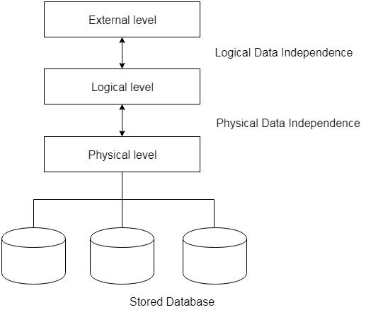

Slide 17
Difference between Physical and Logical Data Independence
Logical Data Independence | Physical Data Independence
Logical Data Independence is mainly concerned with the structure or changing the data definition. | Mainly concerned with the storage of the data.
It is difficult as the retrieving of data is mainly dependent on the logical structure of data. | It is easy to retrieve.
Compared to Logic Physical independence it is difficult to achieve logical data independence. | Compared to Logical Independence it is easy to achieve physical data independence.
You need to make changes in the Application program if new fields are added or deleted from the database. | A change in the physical level usually does not need change at the Application program level.
Modification at the logical levels is significant whenever the logical structures of the database are changed. | Modifications made at the internal levels may or may not be needed to improve the performance of the structure.
Concerned with conceptual schema | Concerned with internal schema
Example: Add/Modify/Delete a new attribute | Example: change in compression techniques, Hasting algorithms, Storage devices, etc

