Slide 1
UNIT-2
Relational data Model and Language: Relational Data Model Concepts, Integrity Constraints, Entity Integrity, Referential Integrity, Keys Constraints, Domain Constraints

Slide 2
RELATIONAL DATA MODEL CONCEPTS
Relational model can represent as a table with columns and rows. Each row is known as a tuple. Each table of the column has a name or attribute.
Domain: It contains a set of atomic values that an attribute can take.
Attribute: It contains the name of a column in a particular table. Each attribute Ai must have a domain, dom(Ai)

Slide 3
Concepts
Relation instance − A finite set of tuples in the relational database system represents relation instance. Relation instances do not have duplicate tuples.
Relation schema − A relation schema describes the relation name (table name), attributes, and their names.
Relation key − Each row has one or more attributes, known as relation key, which can identify the row in the relation (table) uniquely.
Attribute domain − Every attribute has some pre-defined value scope, known as attribute domain.

Slide 4
Example: STUDENT Relation
NAME | ROLL_NO | PHONE_NO | ADDRESS | AGE
Ram | 14795 | 7305758992 | Noida | 24
Shyam | 12839 | 9026288936 | Delhi | 35
Laxman | 33289 | 8583287182 | Gurugram | 20
Mahesh | 27857 | 7086819134 | Ghaziabad | 27
Ganesh | 17282 | 9028 9i3988 | Delhi | 40

Slide 5
In the given table, NAME, ROLL_NO, PHONE_NO, ADDRESS, and AGE are the attributes.
The instance of schema STUDENT has 5 tuples.
t3 = <Laxman, 33289, 8583287182, Gurugram, 20>
Properties of Relations
Name of the relation is distinct from all other relations.
Each relation cell contains exactly one atomic (single) value
Each attribute contains a distinct name
Attribute domain has no significance
tuple has no duplicate value
Order of tuple can have a different sequence

Slide 6
Integrity Constraints
Integrity constraints are a set of rules. It is used to maintain the quality of information.
Integrity constraints ensure that the data insertion, updating, and other processes have to be performed in such a way that data integrity is not affected.
Thus, integrity constraint is used to guard against accidental damage to the database.

Slide 7
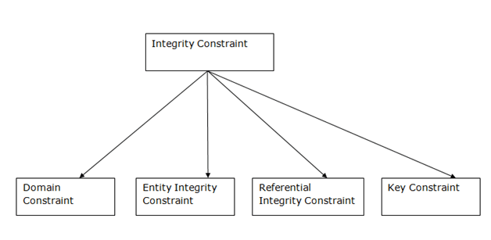
Types of Integrity Constraint

Slide 8
Domain constraints
Domain constraints can be defined as the definition of a valid set of values for an attribute.
The data type of domain includes string, character, integer, time, date, currency, etc. The value of the attribute must be available in the corresponding domain.

Slide 9
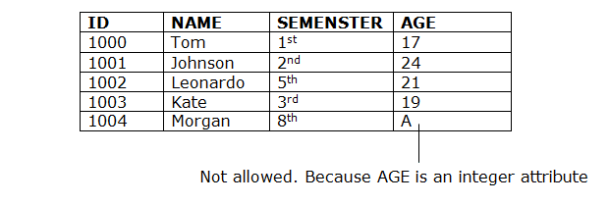
Example:

Slide 10
Entity integrity constraints
The entity integrity constraint states that primary key value can't be null.
This is because the primary key value is used to identify individual rows in relation and if the primary key has a null value, then we can't identify those rows.
A table can contain a null value other than the primary key field.

Slide 11
Example:

Slide 12
Referential Integrity Constraints
A referential integrity constraint is specified between two tables.
In the Referential integrity constraints, if a foreign key in Table 1 refers to the Primary Key of Table 2, then every value of the Foreign Key in Table 1 must be null or be available in Table 2.

Slide 13
Example:

Slide 14
Key constraints
Keys are the entity set that is used to identify an entity within its entity set uniquely.
An entity set can have multiple keys, but out of which one key will be the primary key. A primary key can contain a unique and null value in the relational table.

Slide 15
Example

